Slide 1

BFSI
Credit Score Case Study
RAGHUVEER VEMPATY SHREY TOSHNIWAL
ANKIT KUMAR SRIVASTAVA

Slide 2
Credit risk analysis will help the company to make a decision for loan approval based on the applicant’s profile. Which controls loss of business to the company and avoid financial loss for the company.
SUMMARY (NEED)

Slide 3
Steps
Data understanding and sourcing
Check for Data quality and Binning
Check for Data imbalance and univariate, segmented univariate & Bivariate analysis, Correlation
Data analysis by univariate, segmented univariate & Bivariate analysis, Correlation
Recommendations and Risks

Slide 4
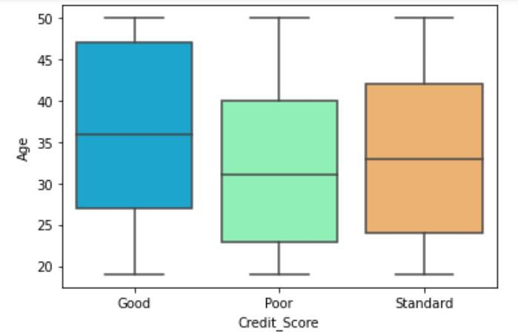
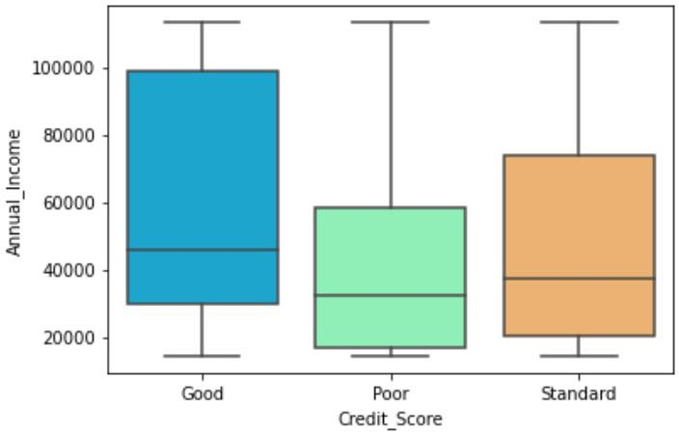
Univariate Analysis of continuous data
Plot shows that customers in the age group of 22 – 40 have poor credit score due to various reasons one can be default in payments and other being low annual income as shown.

Slide 5
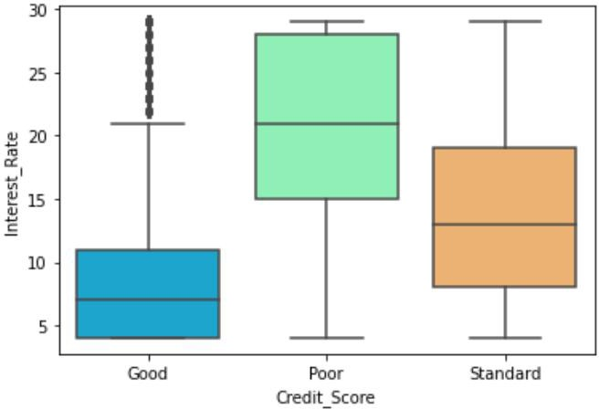
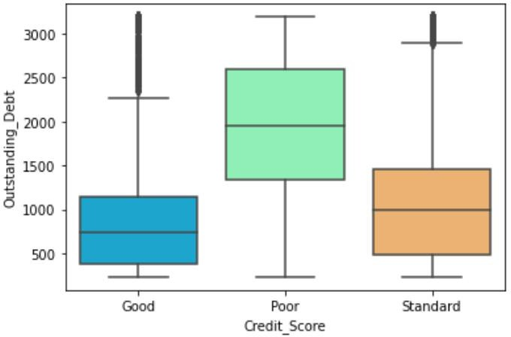
Depicts that outstanding debt and higher interest rates are causing poor credit scores for individuals.

Slide 6
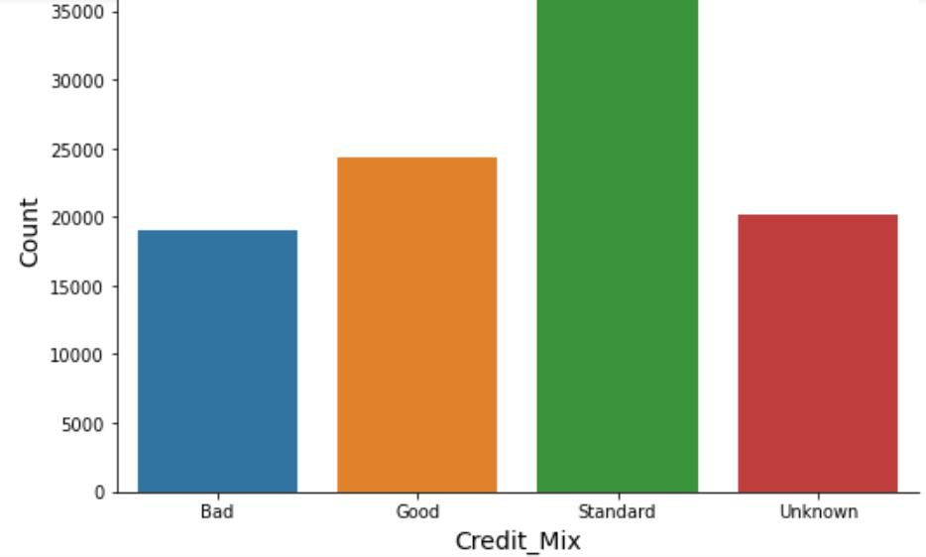
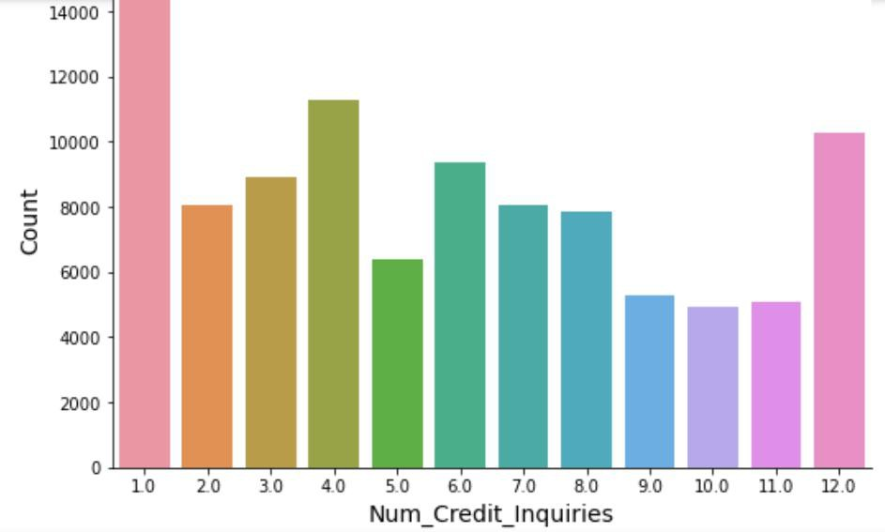
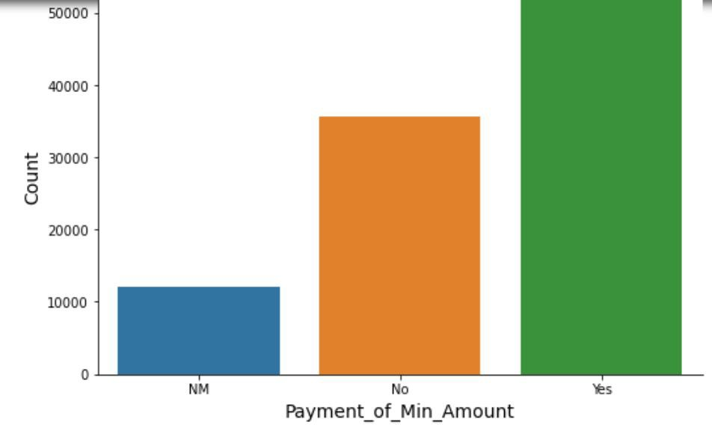
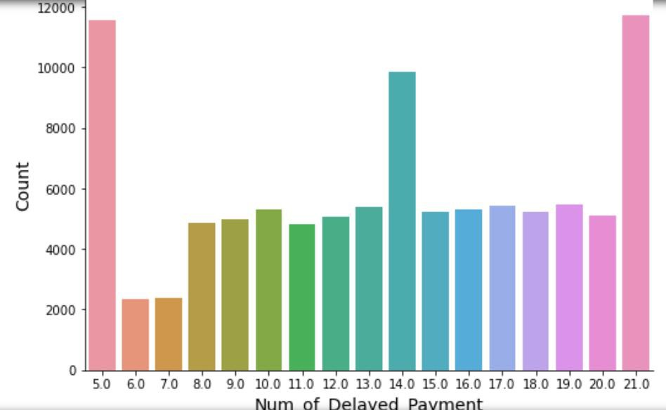
Univariate Analysis on categorical columns

Slide 7
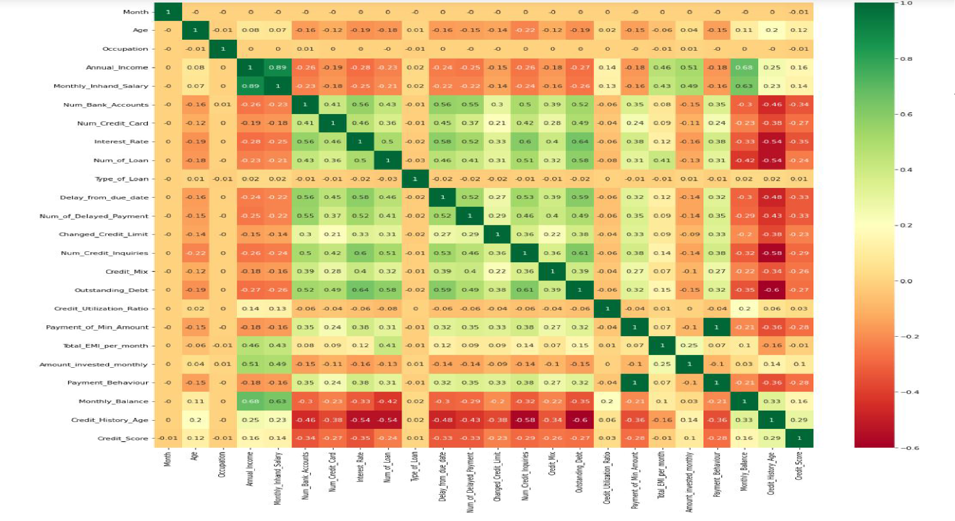
Correlations among the continuous variables

Slide 8
Recommended group where loan can be credited.
Clients who are working as a state servant
Elder people of any income group
Client in high income category
Client with higher education
Any client who’s previous loan was approved
Refreshed client who has unused loan status previously

Slide 9
High risk clients
Previously refused loan status group
Client in young age group with less annual income
High outstanding debt individuals may lead to be defaulters and credit duration and history should be verified.

Slide 10
THANK YOU

